Slide 1
Basic Biological Concepts
Emerging Human Diseases
Section 4 – Lecture 3

Slide 2
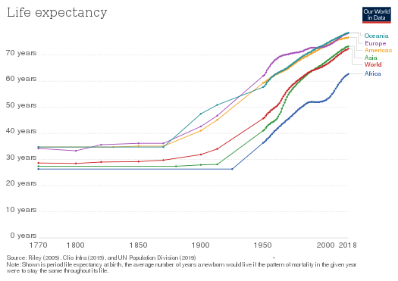
How long do the people of the world live?
America didn’t pass 40 years until 1900
Many others didn’t make it until nearly 1950

Slide 3
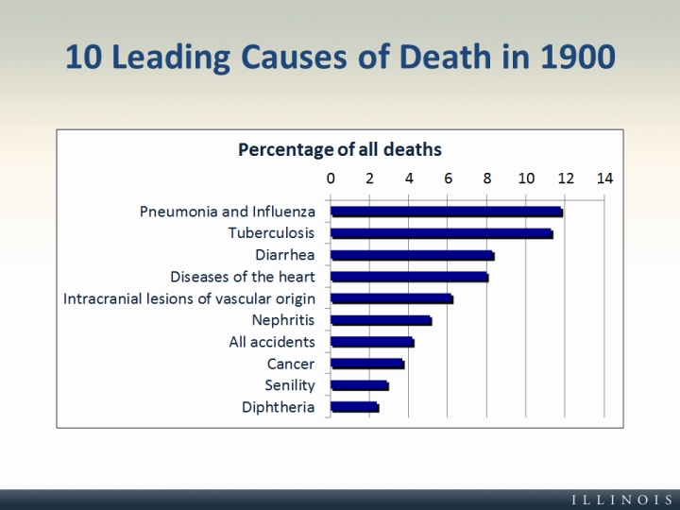
What killed us back then?
Four of the top 10 were infectious diseases

Slide 4
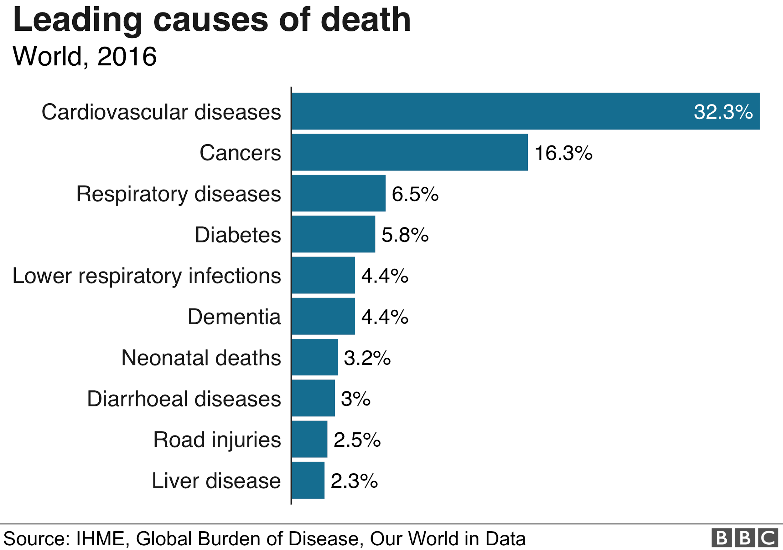
What kills us now?
Chronic diseases and diseases associated with lifestyle have emerged as the top killers.

Slide 5
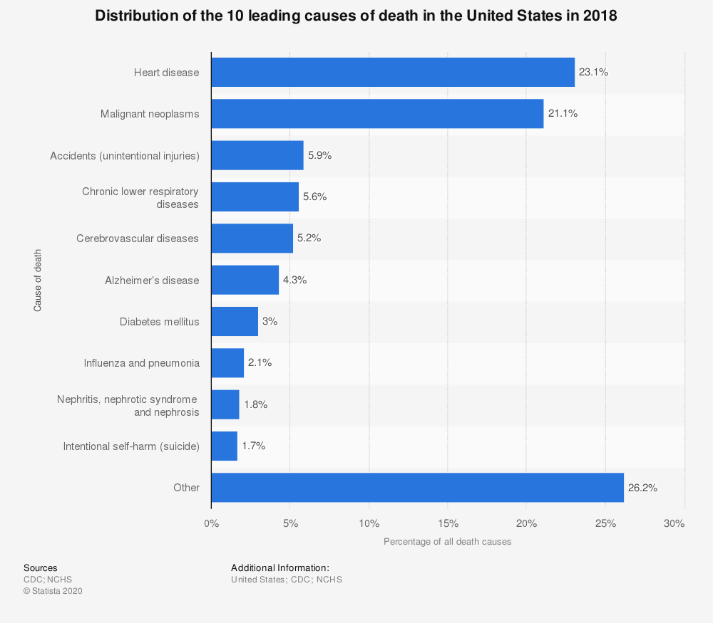
In the US, we have added car accidents and suicide into the Top 10.

Slide 6
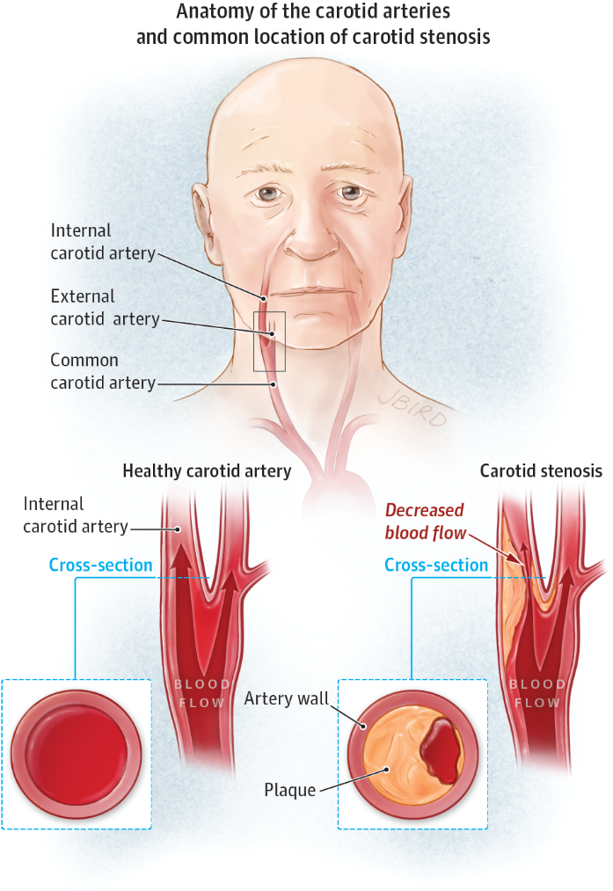
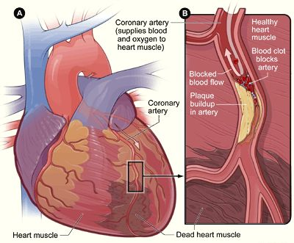
Atherosclerotic Artery Disease
This is ‘emergent’ due to the increased percentage over time.
Coronary Artery Disease:
Blockage (stenosis) of the coronary arteries that feed blood to the heart muscle.
Carotid Artery Disease:
Blockage of the carotid arteries that feed blood to the brain.

Slide 7
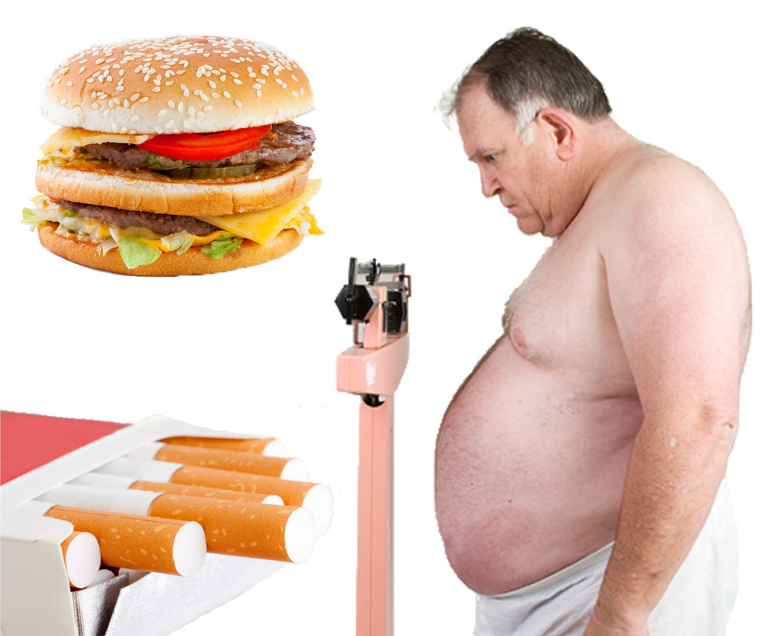
The Standard Risk Factors

Slide 8
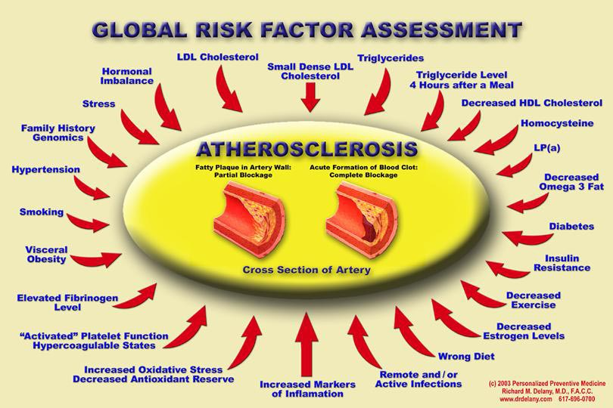
The Real Story
Inflammation from any source can get and keep the process rolling

Slide 9
Cancer is many different diseases with some commonalities
Over 100 types of cancers affect humans.
Cancer is a group of diseases involving abnormal cell growth with the potential to invade or spread to other parts of the body.
These contrast with benign tumors, which do not spread.
Cellular changes cause cells to divide uncontrollably
Some divide very quickly, while others divide more slowly
Normally, cells behaving abnormally must undergo apoptosis
The changes to cancer cells always include evasion of apoptosis
Some form solid tumors but blood cell cancers do not.
Typically, many genetic changes are required before cancer develops.
Many cancers occur at a higher rate in developed countries as more people live to an old age and as lifestyle changes occur.
The financial costs of cancer were estimated at $1.16 trillion USD per year as of 2010

Slide 10
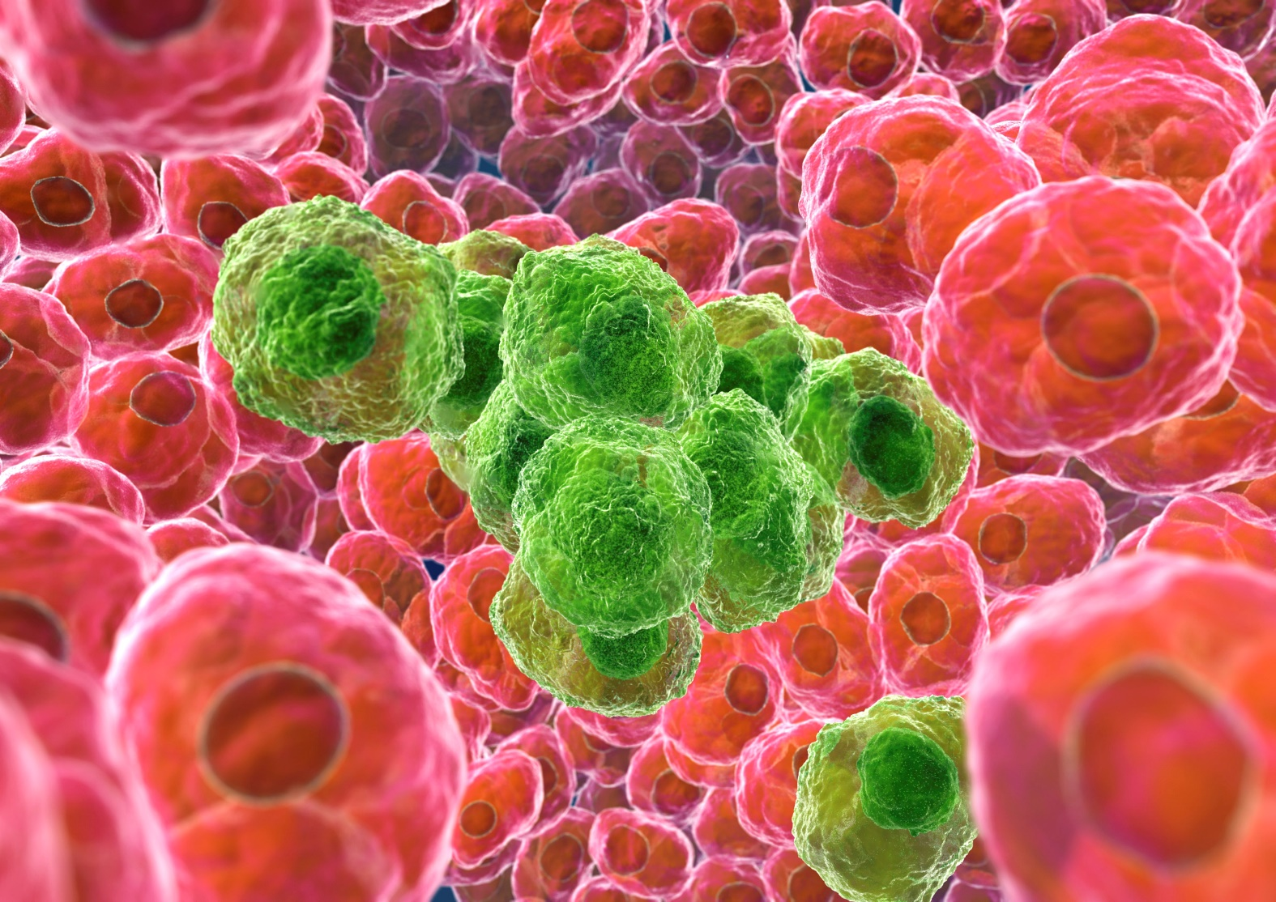
Only about 5–10% of cancers are due to inherited genetic defects from a person's parents.
Tobacco use is the cause of about 22% of cancer deaths.
Another 10% are due to obesity, poor diet, lack of physical activity or excessive drinking of alcohol.
In the developing world, 15% of cancers are due to infections such as:
Helicobacter pylori
Hepatitis B and hepatitis C
Human papillomavirus
Epstein–Barr virus
Human immunodeficiency virus (HIV).
Other factors include exposure to ionizing radiation and environmental pollutants.

Slide 11
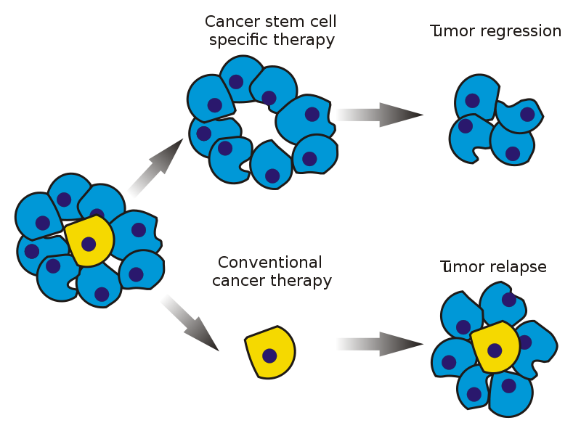
The Cancer Stem Cell Hypothesis
Glioblastomas of the brain
Prostate cancer
Melanoma
Breast cancer
Colon cancer
Pancreatic cancer
Myeloid leukemia

Slide 12
Emergent Viruses
An emergent virus is a virus that has newly appeared, is notably increasing in incidence or geographic range, or has the potential to increase in the near future.
Emergent viruses are a major potential problem because they cause outbreaks and can lead to epidemics and pandemics.
Emergent viruses can also have severe economic implications, as we are seeing now.
Viral emergence in humans is often due to zoonosis, which is a cross-species jump of a viral disease into humans from other animals.
As zoonotic viruses exist in animal reservoirs, they are much more difficult to eradicate and can therefore establish persistent infections in human populations.
Recent examples include:
The SARS-related coronaviruses: the 2002-2004 outbreak of SARS (SARS-CoV-1) and the 2019–20 pandemic of COVID-19 (SARS-CoV-2).
The human immunodeficiency virus which causes HIV/AIDS
The Ebola/Marburg hemorrhagic fever filoviruses
The H5N1 influenza virus responsible for avian flu
H1N1/09, which caused the 2009 swine flu pandemic
An earlier emergent strain of H1N1 caused the 1918 Spanish flu pandemic.

Slide 13
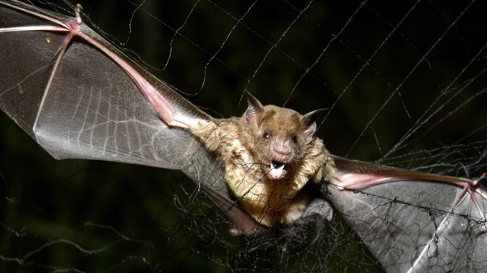
The Role of Bats in Zoonotic Transmission
A successful zoonotic 'jump' depends on human contact with an animal that has a virus that is able to infect humans.
Bats are associated with more zoonotic viruses per host species than any other mammal.
They are natural hosts for high-profile zoonotic viruses, like coronaviruses and Ebola.
Viruses can be transmitted by bite, arosolization of saliva (e.g. during echolocation) and feces/urine.
Due to their ecology, bats are naturally more susceptible to viral infection and transmission.
Several bat species (e.g. brown bats) aggregate in crowded roosts.
Bats are widespread in urban areas and humans can encroach where there are guano and urine.
Their ability to fly and migration patterns also means that bats are able to spread disease over a large geographic area, while also acquiring new viruses.
Bats experience persistent viral infections and long lives (up to 35 years)
Makes them an excellent reservoir for viruses and transmit them to other species.

Slide 14
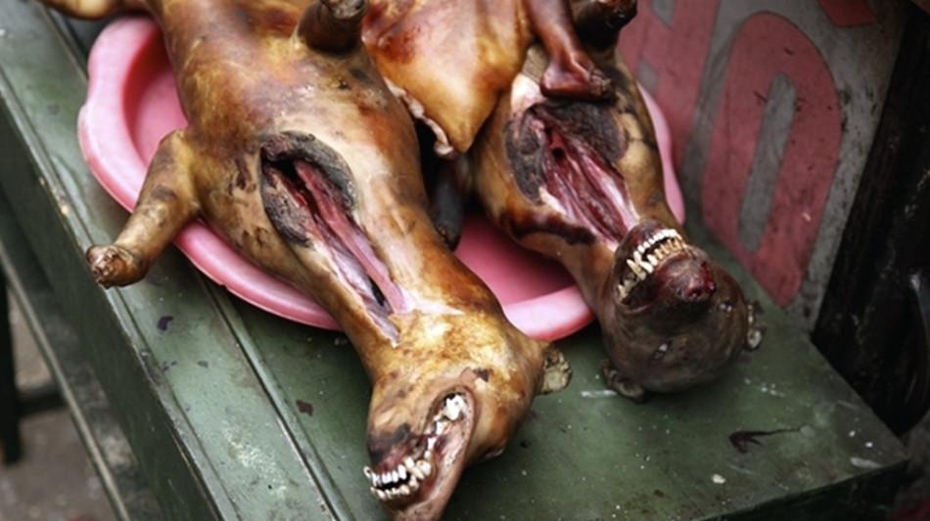
The Role of Humans in Zoonotic Transmission
Ecological changes can facilitate the emergence and re-emergence of zoonotic viruses.
Deforestation and habitat fragmentation can increase human contact with wild animals
Climate change can affect ecosystems and redistribution of animal vectors for viruses.
Densely populated cities promote rapid pathogen transmission.
Viruses may also emerge due to human populations that are vulnerable to infection.
Loss of cross-protective immunity due to termination of vaccination programs.
Higher proportions of old and obese citizens means greater immunosuppression.
Poor nations may have malnutrition, chronic infection or unstable vaccination programs.
International trade and human travel/migration can spread viruses into new areas.
Animal migration can also lead to the emergence of viruses, as was the case for the West Nile virus which was spread by migrating bird populations
Human practices regarding food production and consumption can also contribute
Live animal markets have high density of people and wild/farmed animals present.
Consumption of bush meat is also associated with pathogen emergence

Slide 15
Vaccinations for Viral Diseases
Vaccines "teach" your body how to defend itself when viruses or bacteria invade it:
Vaccines expose you to a very small, very safe amount of viruses or bacteria that have been weakened or killed.
Your immune system then learns to recognize and attack the infection if you are exposed to it later in life.
As a result, you will not become ill, or you may have a milder infection. This is a natural way to deal with infectious diseases.
Four types of vaccines are currently available:
Live virus vaccines use the weakened (attenuated) form of the virus. The measles, mumps, and rubella (MMR) vaccine and the varicella (chickenpox) vaccine are examples.
Killed (inactivated) vaccines are made from a protein or other small pieces taken from a virus or bacteria. The whooping cough (pertussis) vaccine is an example.
Toxoid vaccines contain a toxin or chemical made by the bacteria or virus. They make you immune to the harmful effects of the infection, instead of to the infection itself. Examples are the diphtheria and tetanus vaccines.
Biosynthetic vaccines contain manmade substances that are very similar to pieces of the virus or bacteria. The Hepatitis B vaccine is an example.

Slide 16
WHY WE NEED VACCINES
For a few weeks after birth, babies have some protection passed from their mother through the placenta before birth. After a short period, this natural protection goes away.
Vaccines help protect against many diseases that used to be much more common. Examples include tetanus, diphtheria, mumps, measles, pertussis (whooping cough), meningitis, and polio.
Because of vaccines, many of these illnesses are now rare.
SAFETY OF VACCINES
The American Academy of Pediatrics, the Centers for Disease Control and Prevention (CDC), and the Institute of Medicine conclude that benefits of vaccines outweigh the risks.
Live, attenuated virus vaccines have some risk: measles, mumps, rubella, chickenpox, and nasal spray flu vaccines.
Infections are rare except when a person's immune system is weakened.
People with weakened immune systems should not receive these live vaccines.
These live vaccines may be dangerous to the fetus of a pregnant woman.
Thimerosal is a preservative that was found in most vaccines in the past. But now:
There are infant and child flu vaccines that have no thimerosal.
NO other vaccines commonly used for children or adults contain thimerosal.
Extensive research has NOT shown any link between thimerosal and autism.
Allergic reactions are rare and are usually to some part (component) of the vaccine.

Slide 17
Diabetes Mellitus
A group of diseases that result in too much sugar in the blood (high blood glucose).
MOST COMMON TYPES
Type 2 diabetes: A chronic condition that affects the way the body processes blood sugar (glucose).
Type 1 diabetes: A chronic condition in which the pancreas produces little or no insulin.
Prediabetes: A condition in which blood sugar is high, but not high enough to be type 2 diabetes.
Gestational diabetes: A form of high blood sugar affecting pregnant women.
Type 1 diabetes can develop at any age, though it often appears during childhood or adolescence.
Type 2 diabetes, the more common type, can develop at any age, though it's more common in people older than 40.

Slide 18
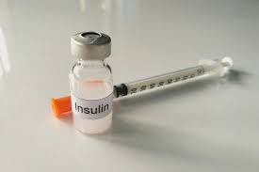
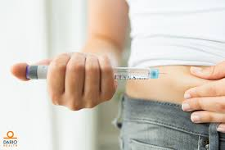
Signs and symptoms of type 1 and type 2 diabetes are:
Increased thirst
Frequent urination
Extreme hunger
Unexplained weight loss
Presence of ketones in the urine (ketones are a byproduct of the breakdown of muscle and fat that happens when there's not enough available insulin)
Fatigue
Irritability
Blurred vision
Slow-healing sores
Frequent infections, such as gums or skin infections and vaginal infections

Slide 19
Causes of type 1 diabetes
The exact cause of type 1 diabetes is unknown.
Your immune system attacks and destroys your insulin-producing cells in the pancreas. This leaves you with little or no insulin.
Instead of being transported into your cells, sugar builds up in your bloodstream.
Type 1 is thought to be caused by a combination of genetic susceptibility and environmental factors.
Causes of prediabetes and type 2 diabetes
Your cells become resistant to the action of insulin, and your pancreas is unable to make enough insulin to overcome this resistance.
Instead of moving into your cells where it's needed for energy, sugar builds up in your bloodstream.
Genetic and environmental factors play a role in type 2 diabetes as well.
Being overweight is strongly linked to the development of type 2 diabetes, but not everyone with type 2 is overweight.
Causes of gestational diabetes
During pregnancy, placental hormones make your cells more resistant to insulin.
Normally, your pancreas responds by producing enough extra insulin to overcome this resistance. But sometimes your pancreas can't keep up.
When this happens, too little glucose gets into your cells and too much stays in your blood.

Slide 20
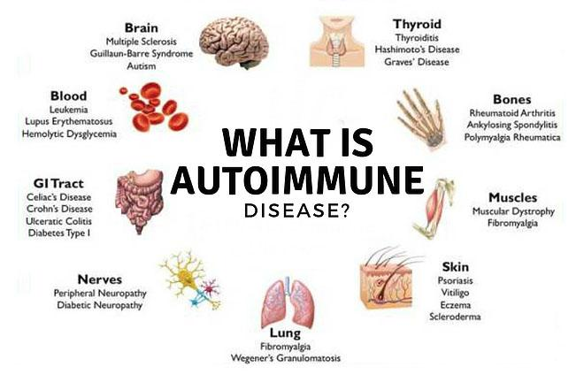
Autoimmune Diseases
An autoimmune disease is a condition in which your immune system mistakenly attacks your body.
The immune system normally guards against bacteria and viruses. When it senses these foreign invaders, it sends out an army of fighter cells to attack them.
Normally, the immune system can tell the difference between foreign cells and your own cells.
In an autoimmune disease, the immune system mistakes part of your body, like your joints or skin, as foreign.
Some autoimmune diseases target only one organ. Type 1 diabetes damages the pancreas. Other diseases, like systemic lupus erythematosus (SLE), affect the whole body.

Slide 21
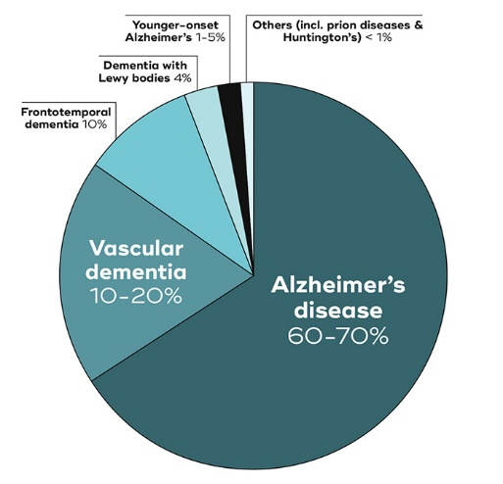
Dementia Disorders
A group of thinking and social symptoms that interferes with daily functioning.
Not a specific disease, dementia is a group of conditions characterized by impairment of at least two brain functions, such as memory loss and judgment.
Symptoms include forgetfulness, limited social skills, and thinking abilities so impaired that it interferes with daily functioning.
Medications and therapies may help manage symptoms. Some causes are reversible.
Very common
More than 3 million US cases per year
Treatment can help, but this condition can't be cured
Chronic: can last for years or be lifelong
Different types
Alzheimer’s disease
Vascular dementia
Frontotemporal
Lewy body dementia
Parkinson’s
Creutzfeldt-Jakob
Wernicke-Korsakoff
Mixed dementia
Normal pressure hydrocephalus
Huntington’s disease
Other causes

Slide 22

The Autism Spectrum Disorders
Increasingly Common: More than 200,000 US cases per year
Characterized by difficulties with social interaction and communication, and by restricted and repetitive behavior.
Parents often notice signs during the first three years of their child's life.
Signs may develop gradually, worsening in communication and social skills after reaching developmental milestones at a normal pace.
Autism is associated with a combination of genetic and environmental factors.
Risk factors during pregnancy include certain infections, such as rubella, toxins including valproic acid, alcohol, cocaine, pesticides, lead, and air pollution, fetal growth restriction, and autoimmune diseases.
Controversies surround other proposed environmental causes; for example, the vaccine hypothesis, which has been disproven.

Slide 23
Environmental Toxins
Environmental Toxicology is the study of the harmful effects of various chemical, biological and physical agents on living organisms. Types of Environmental Toxins.
Ecotoxicology is a subdiscipline of environmental toxicology concerned with studying the harmful effects of toxicants at the population and ecosystem levels.
Rachel Carson made it a distinct field within toxicology in 1962 with the publication of her book Silent Spring, which covered the effects of uncontrolled pesticide use.
Types of Environmental Toxins.
Environmental chemicals: Polychlorinated biphenyls (PCBs), dioxin, hexochlorobenzene, pthalates, ethidium bromide, methyl mercury, cadmium, selenium, lead, zinc, fertilizers and many more.
Drugs and medications: Tobacco, caffeine, ethanol, retinoic acid, benzodiazopines, phenytoins, estrogens, androgens, diethylstilbestrol, lithium, penicillamine, tetracyclines, thalidomide, trimethadone and many more.
Infections: cytomegalovirus, herpes virus, parvovirus B19, rubella virus, syphilis, toxoplasmosis, equine encephalitis virus
Ionizing radiation: diagnostic x-rays, radiation therapy, background radiation, atomic weapon fallout.

Slide 24
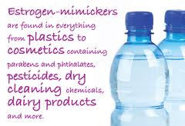
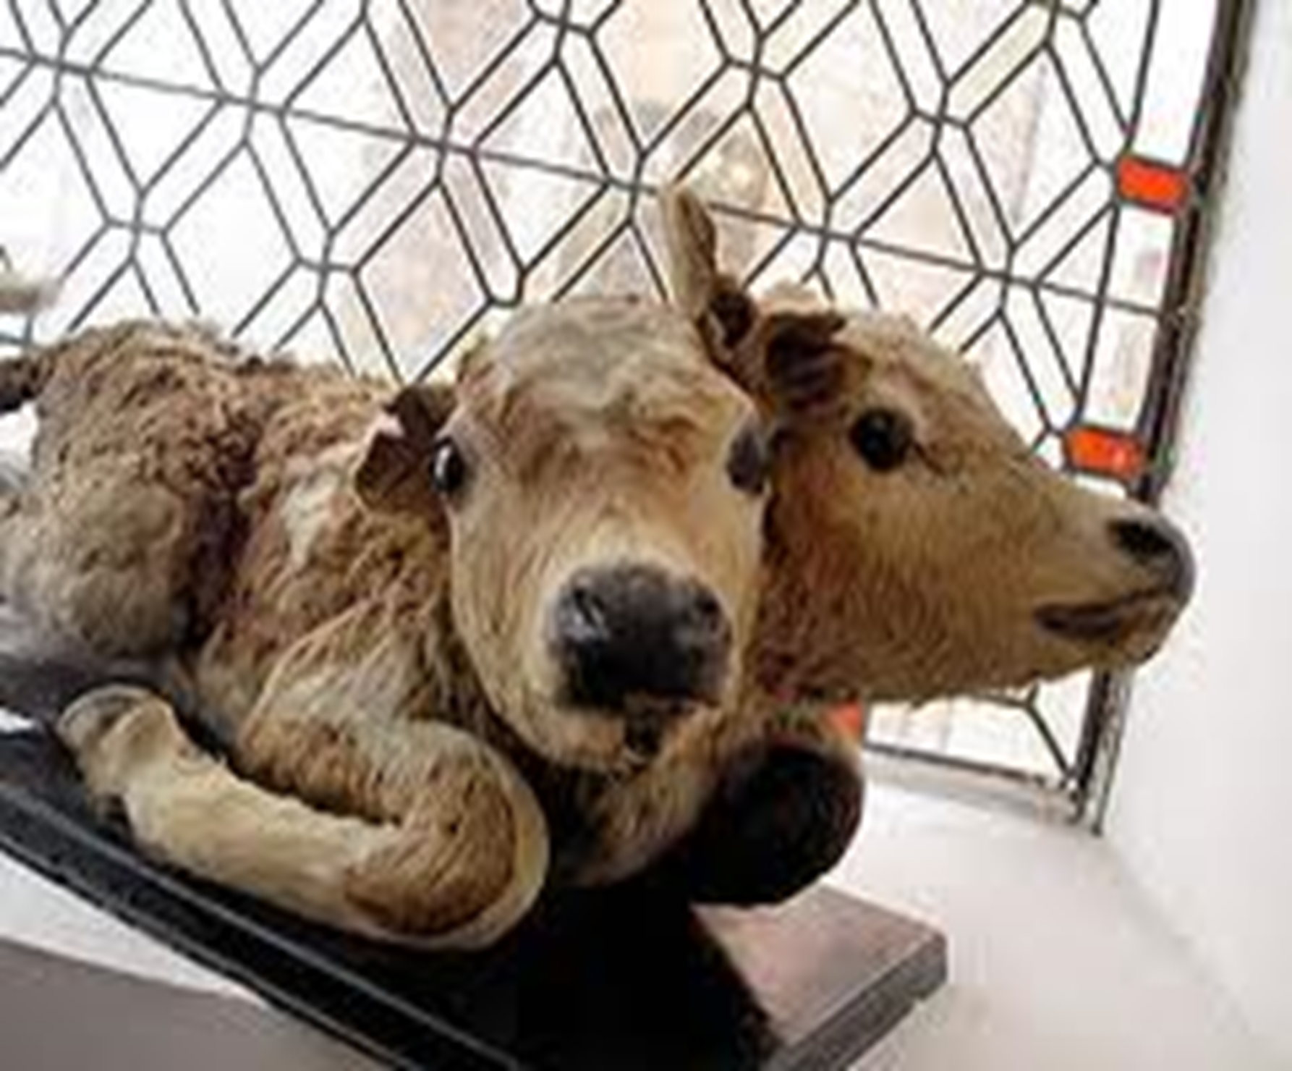
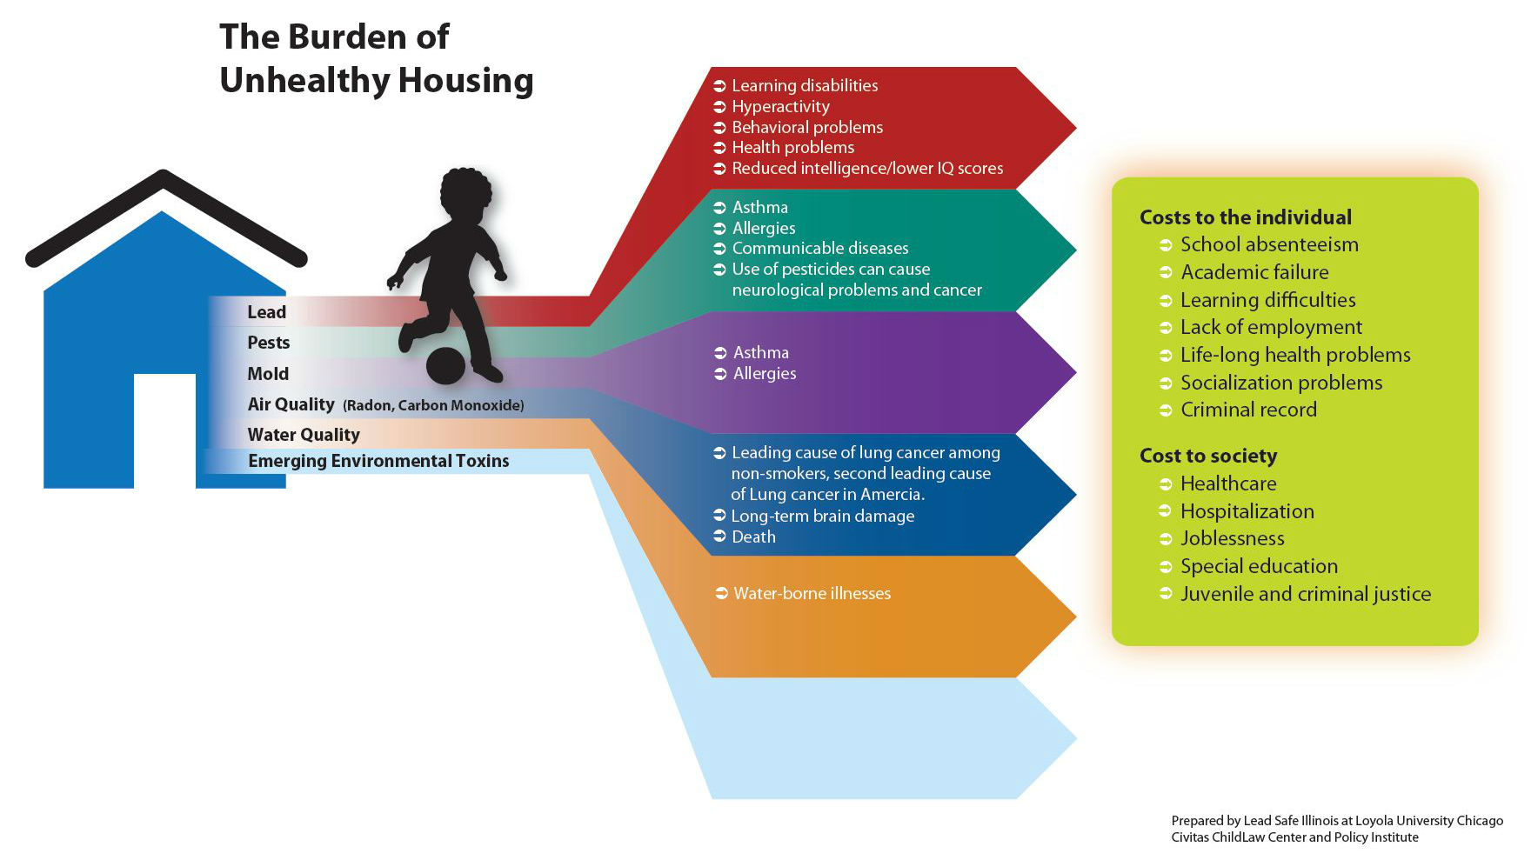
Contaminants are Found Increasingly Commonly in Our Lives
Toxic
Plants
Man Made
Around the House

Slide 25
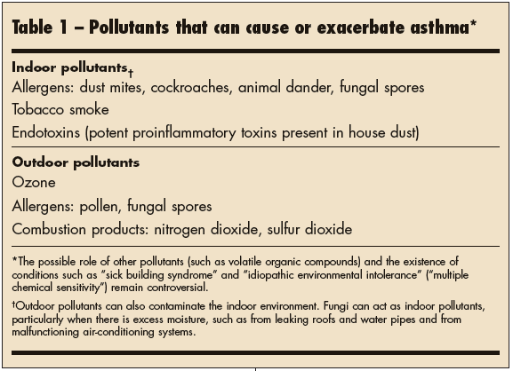
Asthma and Household Toxicants
Is asthma genetic or environmental?
Asthma is not contagious.
Researchers have determined that asthma can be caused by both hereditary (inherited) and environmental factors.
Just because you have a parent with asthma (or an allergy) doesn't mean you'll have it too.
But you might inherit the tendency to develop asthma.

Slide 26
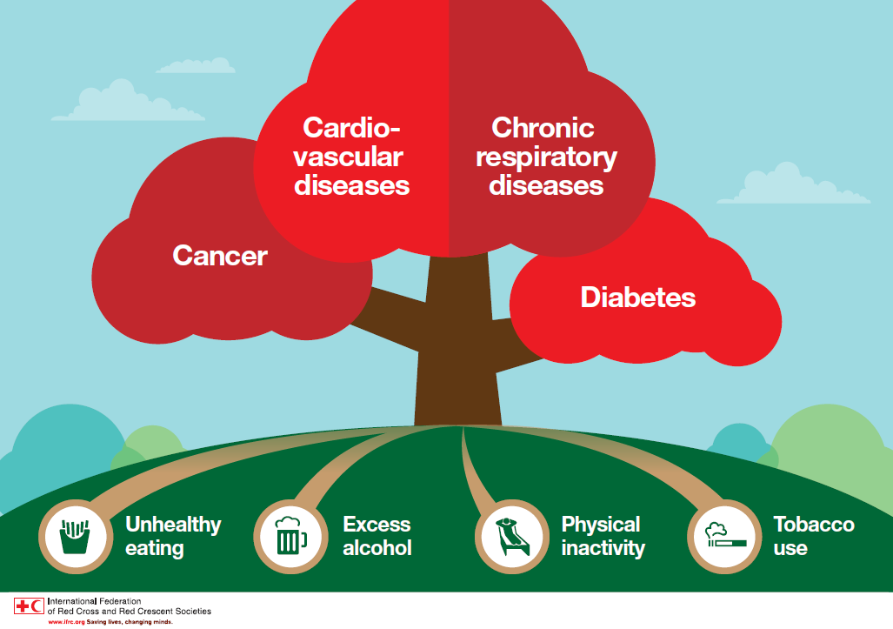
Lifestyle Risk Factors
Nutrition, Inactivity and Obesity
Tobacco Use
Substance Abuse

Slide 27

Nutrition, Inactivity and Obesity
Good nutrition, physical activity, and a healthy body weight are essential parts of a person’s overall health and well-being.
Can help decrease a person’s risk of developing serious health conditions, such as high blood pressure, high cholesterol, diabetes, heart disease, stroke, and cancer.
They are also paramount to managing health conditions so they do not worsen over time.
Most Americans, however, do not eat a healthful diet and are not physically active at levels needed to maintain proper health.
Americans' average daily fruit and vegetable consumption does not meet intake
A majority of adults (81.6%) and adolescents (81.8%) do not get the recommended amount of physical activity.
Today, 1 in 3 adults (34.0%) and 1 in 6 children and adolescents (16.2%) are obese.
Overweight and obesity significantly increase medical costs and pose a staggering burden on the U.S. medical care delivery system.

Slide 28
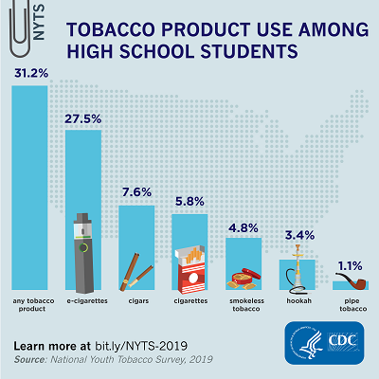
Tobacco Use
Cigarette smoking is the leading cause of preventable disease and death in the United States, accounting for more than 480,000 deaths every year, or about 1 in 5 deaths.
More than 16 million Americans live with a smoking-related disease.
Smoking kills more people than HIV, illegal drugs, alcohol, motor-vehicle injuries, suicides and murders combined every year.
In 2018, 14 of every 100 U.S. adults, or 34.2 million smoked cigarettes.
Second hand smoke can cause preventable illnesses as well.
Tobacco companies are constantly looking to develop new products to keep current users addicted and to hook new ones.
Currently, these new products include
snus, hookah and electronic cigarettes.
They are still addictive and deadly, and
many produce harmful second hand smoke.

Slide 29

Smoking harms nearly every organ in the body and increases the risk of:
Coronary heart disease by two to four times.
Stroke by two to four times.
Lung cancer in men by 23 times.
Lung cancer in women by 13 times.
Chronic obstructive lung diseases (chronic bronchitis and emphysema) by 12 to 13 times.
Cigarette smokers are 20x more likely to develop lung cancer than nonsmokers.
Cigars can contain up to 70 times as much nicotine as cigarettes which is absorbed whether or not the smoke is inhaled. Cigar smokers are four to 10 times more likely to die than nonsmokers from:
Laryngeal cancer
Oral cancer
Esophageal cancer
Chew and Snuff
Users let the tobacco sit in their mouths and suck on its “juices,” which allows nicotine to be quickly absorbed into the bloodstream.
In general, the amount of nicotine absorbed from a can of chewing tobacco is equal to the amount delivered by three to four packs of cigarettes.
Smokeless tobacco carries its own set of risks that can lead to:
Cavities
Yellow teeth
Recession of the gums
Mouth sores
Mouth cancer
Heart disease

Slide 30
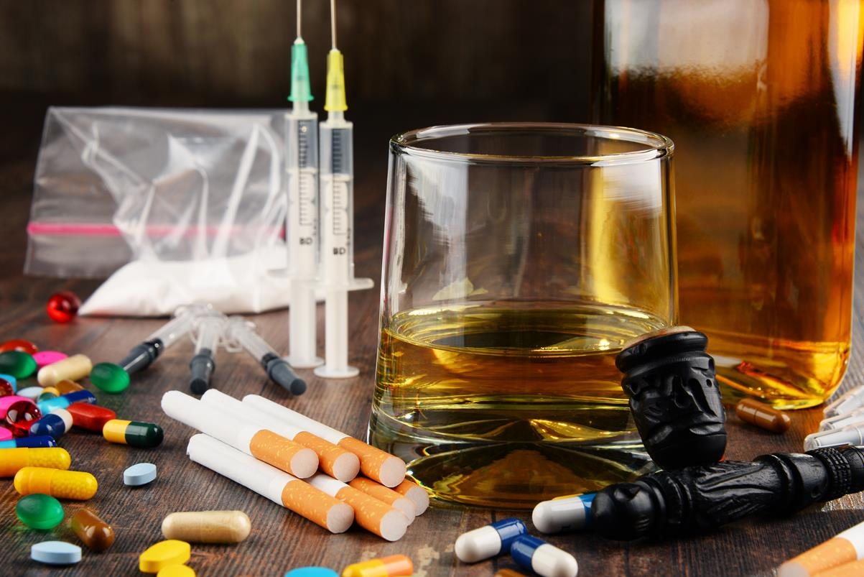
Substance Abuse
Substance abuse is use of a drug in amounts or by methods which are harmful to the individual or others.
Can cause criminal or anti-social behavior to occur.
Long term personality changes in individuals may also occur.
Use of some drugs may also lead to criminal penalties, although these vary widely depending on the local jurisdiction.
Drugs most often associated with this include: alcohol, amphetamines, barbiturates, benzodiazepines, cannabis, cocaine, hallucinogens, methaqualone, and opioids.
In 2010 about 5% of people (230 million) used an illicit substance.
Of these 27 million have high-risk, recurrent drug use causing harm to their health, psychological problems, or social problems.
In 2015 substance use disorders resulted in 307,400 deaths, up from 165,000 deaths in 1990.
Alcohol use disorders 137,500 deaths
Opioid use disorders 122,100 deaths
Amphetamine use disorders 12,200 deaths
Cocaine use disorders contributed deaths

Slide 31
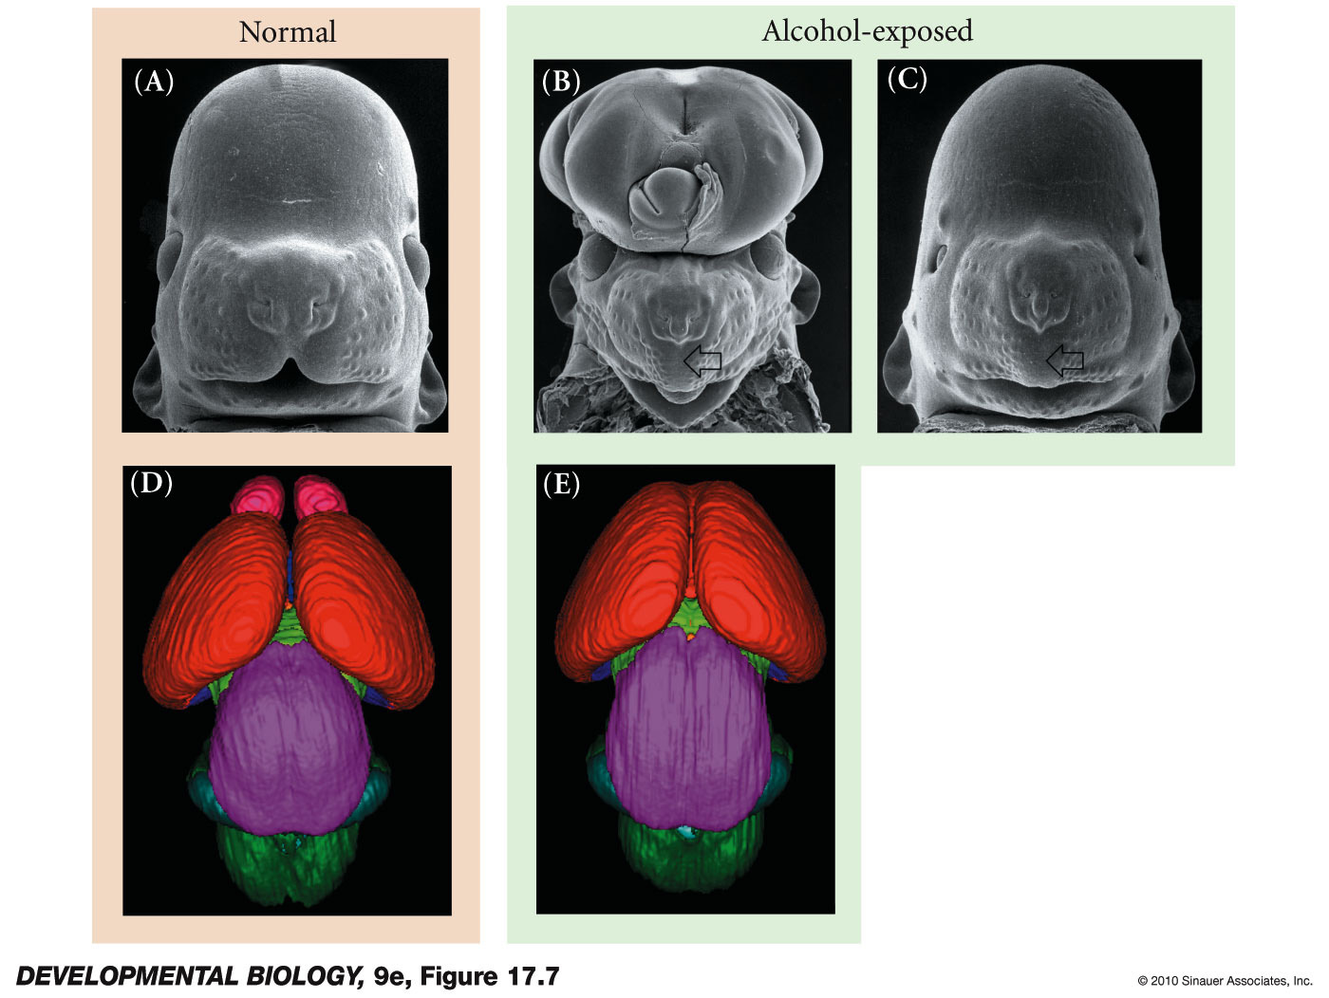
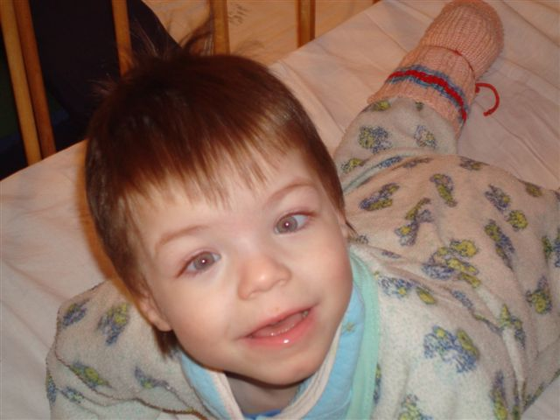
Not Just Hard on the User: Fetal Alcohol Syndrome
Notes:
DevBio9e-Fig-17-07-0.jpg

Slide 32
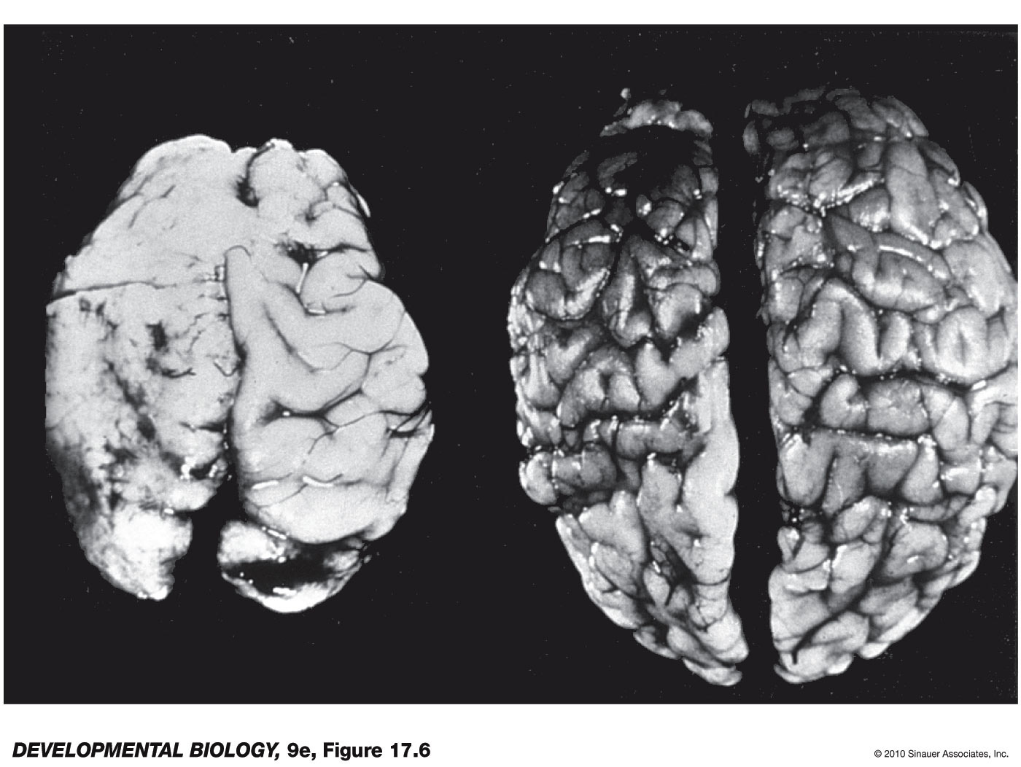
Comparison of a brain from an infant with fetal alcohol syndrome (FAS) with a brain from a normal infant
Notes:
DevBio9e-Fig-17-06-0.jpg

